Slide 1
Property Price Analysis Brisbane Southern Suburbs 2019
Frank He
09 August 2019

Slide 2
Overview and Introduction
Background story:
My friend JV has been promoted to a manager role recently, while his income grows and the Bank interest rate is at historical low, he is looking for an investment property. As his best friend, I'm trying to help him with my data science skills.
We are targeting at Southern Suburbs in Brisbane, QLD, Australia, not only because the rapid population growth in this area, the large investments in infrastructures and potential bid for 2032 Olympic Games, but also JV wants to have it close to where he lives so he could manage the property and tenants himself.
The problem we want to solve:
Of all the Southern suburbs in Brisbane, we would like to find out which ones are most undervalued and worth investing.

Slide 3
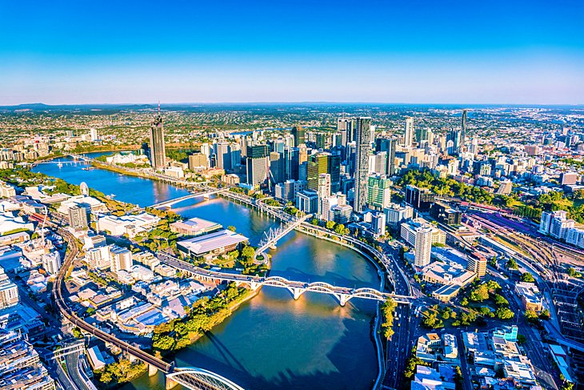
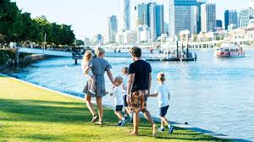
Overview and Introduction
About Brisbane:
Brisbane is the capital of and the most populated city in the Australian state of Queensland, and the third most populous city in Australia. Brisbane's metropolitan area has a population of approximately 2.5 million, and the South East Queensland metropolitan region, centered on Brisbane, encompasses a population of more than 3.6 million.
https://en.wikipedia.org/wiki/Brisbane

Slide 4
The Plan - Data:
Data were sourced from below:
Brisbane Suburb List: https://www.brisbane.qld.gov.au/about-council/council-information-and-rates/brisbane-suburbs
Brisbane Region Classification: https://en.wikipedia.org/wiki/List_of_Brisbane_suburbs
Geospatial Data: http://www.corra.com.au/australian-postcode-location-data/
Brisbane House Information by Suburbs: https://homesales.com.au/location/brisbane-qld/
Venues Information: https://api.foursquare.com/v2/venues/
We will collect Brisbane Suburb list, Regions Classifications, Geospatial data, House information such as Median House Price 2019, Population and income, and also venues information from foursquare API.

Slide 5
The Plan - Methodology:
Methodology :
Using Unsupervised Machine Learning Algorithms: K-means clustering to cluster the suburbs.(Using Elbow Graph to find the best K).
Then using Supervised Machine Learning Algorithms: Multiple linear regression to set up the model by clustered groups.
Using Regions other than Southern to train the model and then predict Southern Region suburbs house prices, comparing the predicted value with the market value to determine whether the suburb is undervalued or not

Slide 6
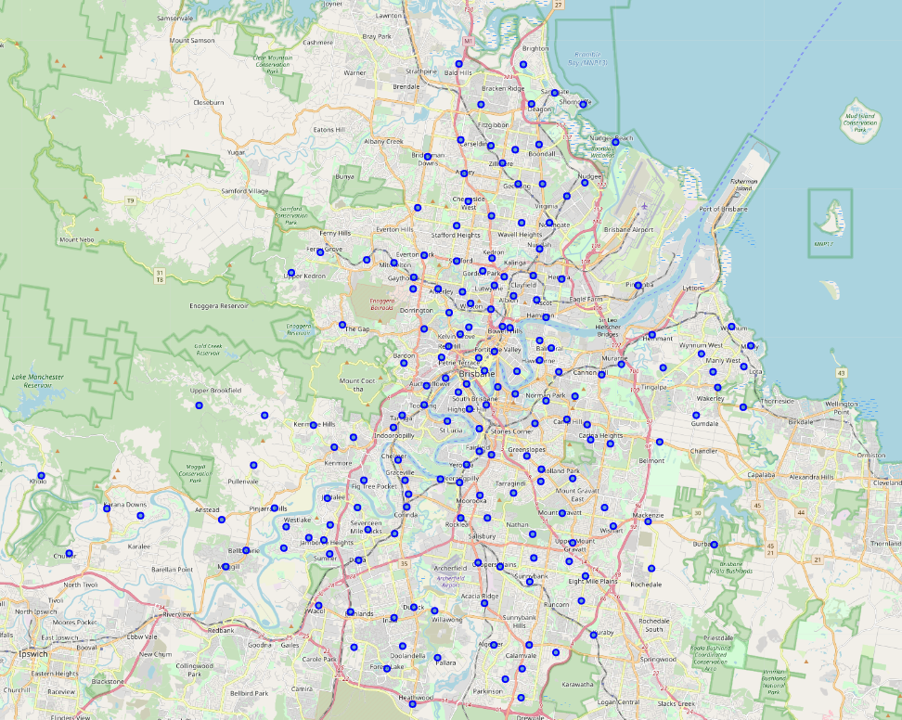
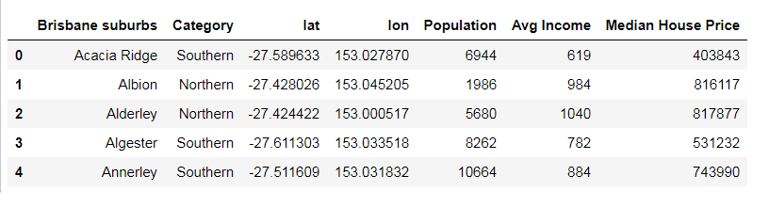
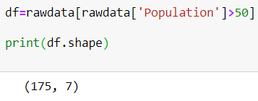
Let’s start!
Firstly, the data has been merged and cleaned, transformed to below format.
By filtering out the suburbs with population under 51 (excluding some industrial suburbs),we have 175 suburbs as plot in the map on the right

Slide 7
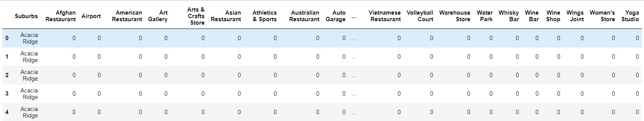

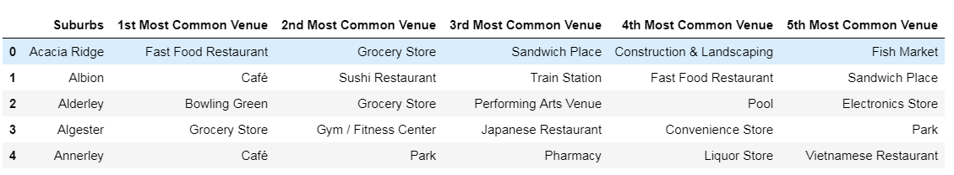
Let’s start!
Next step is to use Foursquare API to extract venue information for the Brisbane Suburbs
There are 254 unique venue categories
We use Min-Max Scaler method to normalize the data and transform into Pandas Data frame format.

Slide 8
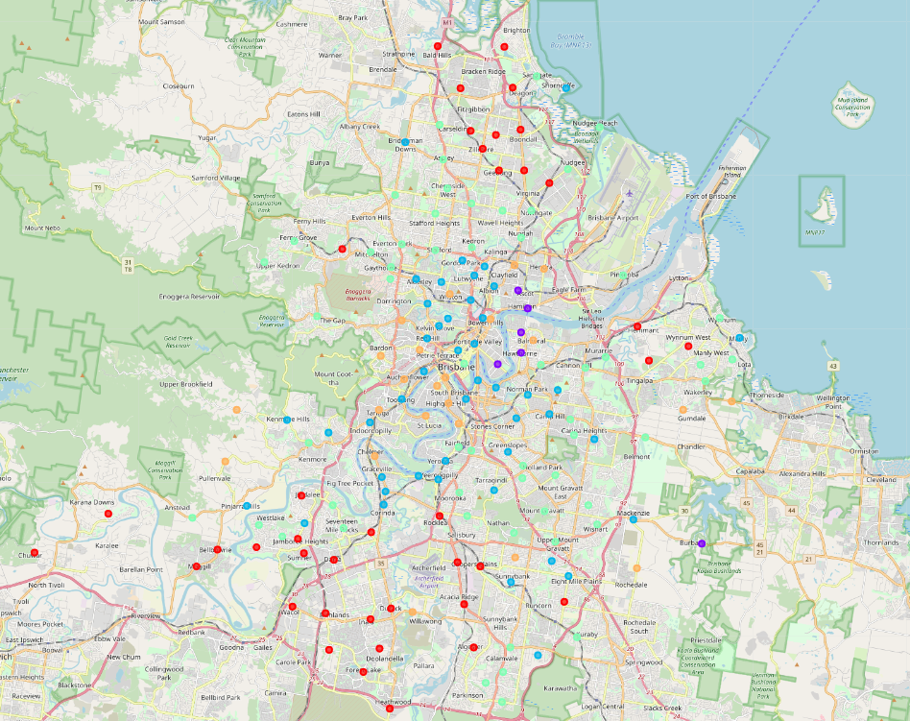
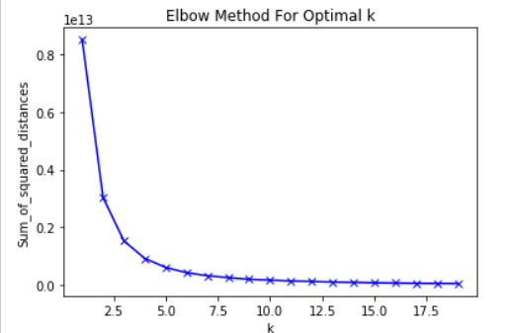
Unsupervised Machine Learning – K Means Algorithm
We want to use K Means Algorithm to cluster the suburbs by the venues they have.
To determine the Best K, here we have used the Elbow Method.
After several tests, we found that combining the population, income and house price data with venues information will give us the best K =5.
Suburbs now have been clustered into 5.

Slide 9
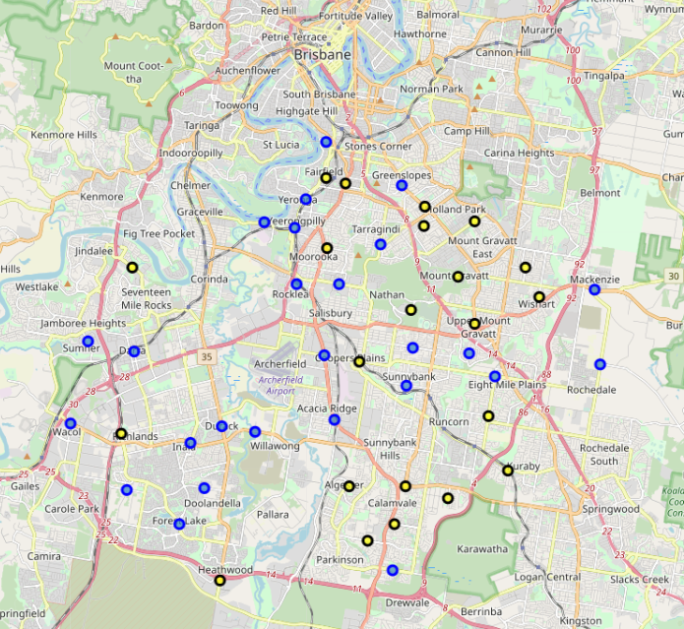
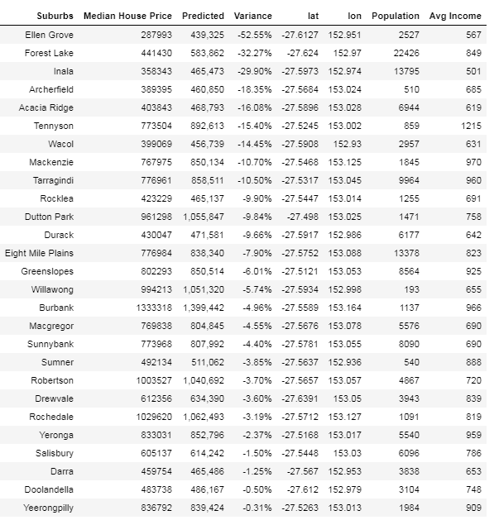
Supervised Machine Learning – Multiple Linear Regression Algorithm
We use Multiple Linear Regression model to predict Southern Brisbane Suburbs within the 5 clusters. Trained with Inner, Northern, Eastern and Western data. The undervalued outcome for Southern suburbs showing as below, we have plot the undervalued with blue and the overvalued ones with yellow.

Slide 10
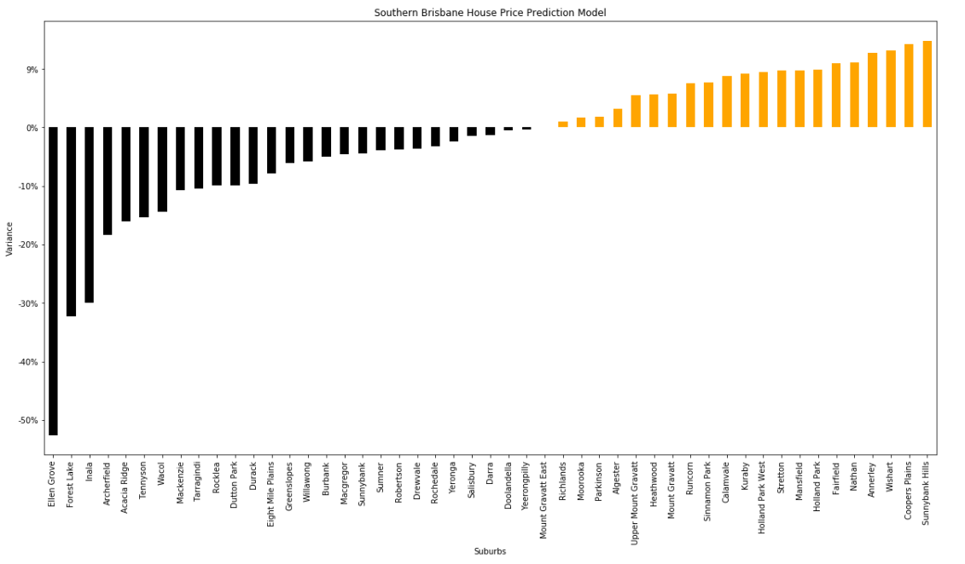
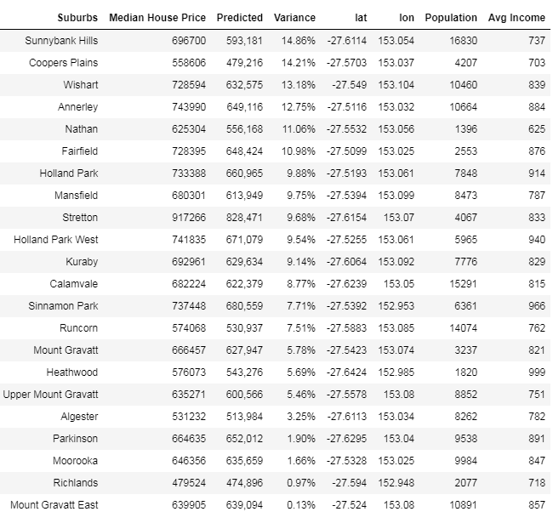
Observation
The histogram on the right also shows that Ellen Grove would be the most undervalued suburbs in Southern Brisbane, with median market price of $280K and predicted price of $440K, undervalued by 52%, while Sunnybank Hills is the most overvalued Suburb, overvalued by 15%.

Slide 11

Conclusion
We have used the Unsupervised Machine Learning Algorithms: K-means clustering and Supervised Machine Learning Algorithms: Multiple linear regression to predict whether a suburb in Southern Brisbane is undervalued. From the analysis, seems that the west side of the Southern Brisbane Suburbs have been undervalued most. Especially Ellen Grove, which has a median market price of AUD 288K and predicted price of AUD 440K.
This analysis might have some limitations as there are many other factors other than venues, population, income that have impacts on House Prices. A more sophisticated model can be built incorporating data such as crime rates, employment rates, school rankings, etc...
However, my friend JV is happy enough with the initial analysis and planned his weekend house inspections around Ellen Grove and Forest Lake, let's wish him good luck.
Thank you for reviewing

